Slide 1

Achieving Results
in the STAAR Initiative
Pat Rutherford MS, RN
Vice President, Institute for Healthcare Improvement
Co-Principal Investigator, STAAR Initiative
April 23, 2012
This presenter has nothing to disclose

Slide 2
Session Objectives
After this session participants will be able to:
Identify promising approaches to reduce avoidable rehospitalizations
Describe IHI strategies and key interventions utilized to improve care transitions and reduce avoidable rehospitalizations

Slide 3
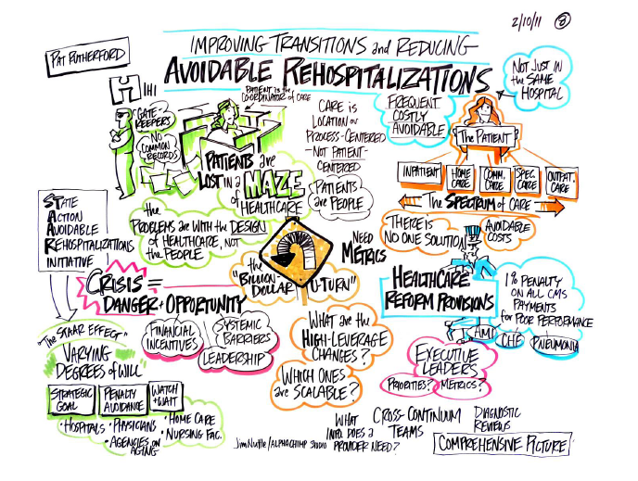

Slide 4
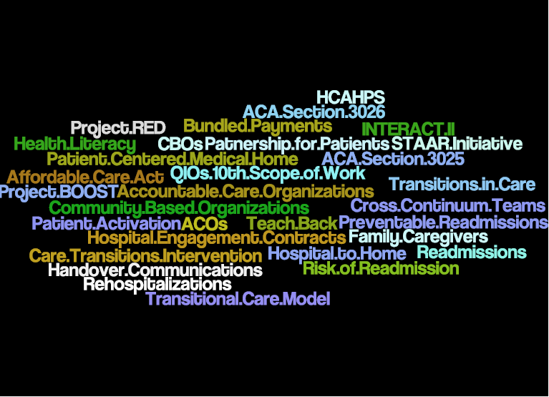

Slide 5
What can be done, and how?
There exist a growing number of approaches to reduce
30-day readmissions that have been successful locally
Which are high leverage?
Which are scalable?
Success requires engaging clinicians, providers across organizational and service delivery types, patients, payers, and policy makers
How to align incentives?
How to catalyze coordinated effort?

Slide 6

Determinants of Preventable Readmissions
Patients with generally worse health and greater frailty are more likely to be readmitted
There is a need to address the tremendous complexity of variables contributing to preventable readmissions
Identification of determinants does not provide a single intervention or clear direction for how to reduce their occurrence
Importance of identifying modifiable risk factors (patient characteristics and health care system opportunities)
Preventable hospital readmissions possess the hallmark characteristics of healthcare events prime for intervention and reform > leading topic in healthcare policy reform

Slide 7
The Bad News:
There are No “Silver or Magic Bullets”!
….no straightforward solution perceived to have extreme effectiveness
_______________________
Hansen, Lo, Young, RS, et al., Interventions to Reduce
30-Day Rehospitalizations: A Systematic Review
Ann Int Medicine 2011; 155:520-528.
Conclusion: “No single intervention implemented
alone was regularly associated with reduced risk
for 30-day rehospitalization.”

Slide 8
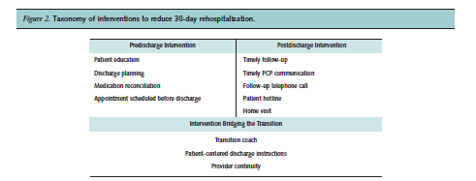
Interventions to Reduce 30-Day Rehospitalizations: A Systematic Review
Ann Int Medicine 2011; 155:520-528

Slide 9

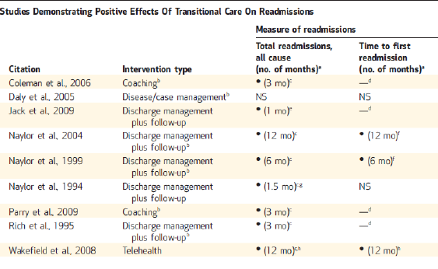
Notes:
9 studies
6 of 9 studies focused on improved discharge preparations
All 9 studies included enhanced self-management support for patients (transitional care models or ???)

Slide 10
The Good News: There are Promising
Approaches to Reduce Rehospitalizations
Improved transitions out of the hospital
  Project RED
  BOOST
  IHI’s Transforming Care at the Bedside and STAAR Initiative
  Hospital to Home “H2H” (ACC/IHI)
Reliable, evidence-based care in all care settings
  PCMH, INTERACT, VNSNY Home Care Model
Supplemental transitional care after discharge from the hospital
  Care Transitions Intervention (Coleman)
  Transitional Care Intervention (Naylor)
Alternative or intensive care management for high risk patients
  Proactive palliative care for patients with advanced illness
  Evercare Model
  Heart failure clinics
  PACE Program and other programs for dual eligibles
  Intensive care management from primary care or health plan

Slide 11
Transition from Hospital to Home
Post-Acute Care Activated
Alternative or Supplemental Care for High-Risk Patients *
Improved Transitions
and Coordination
of Care
Reduction in
Avoidable
Rehospitalizations
Evidence-based Care in Community Care Settings
(Better Models of Care)
* Additional Costs for these Services
Patient and Family Engagement
Key Design Elements
Cross-Continuum Team Collaboration
Health Information Exchange and Shared Care Plans
Notes:
Myriad payer-based discharge planning and care coordination services create chaos at provider level. How can interests be aligned and coordinated?

Slide 12

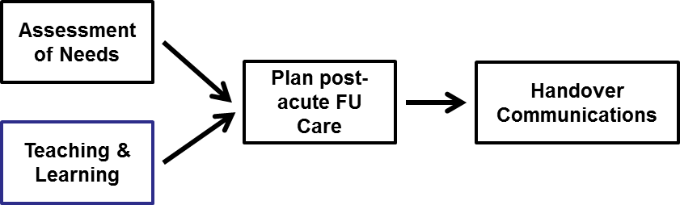
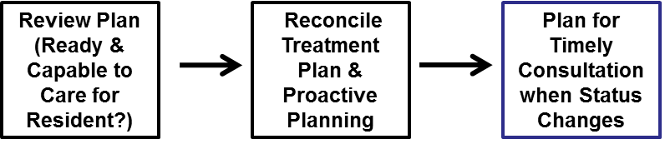

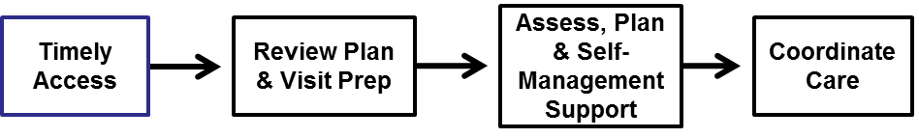

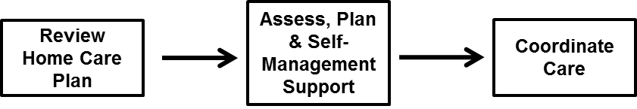
Process Changes to Achieve an Ideal Transition from Hospital (or SNF) to Home
Skilled Nursing Care Centers
Hospital
Primary & Specialty Care
Home (Patient & Family Caregivers)
Home Health Care

Slide 13
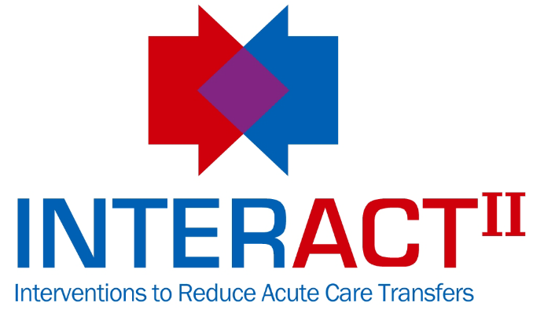




Evidence-based Care in Community Settings (Better Models of Care)
ProvenHealthSM Navigator

Slide 14



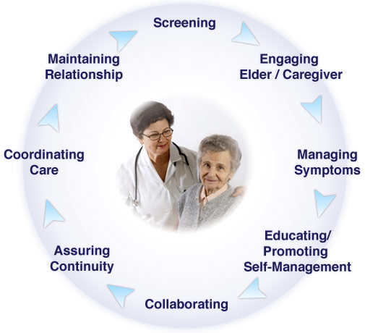
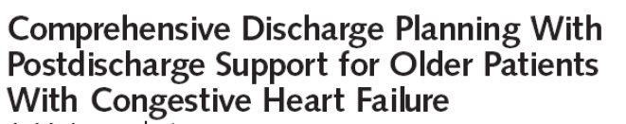
Alternative or Supplemental Care for High Risk Patients
The Transitional Care
Model (TCM)

Slide 15
More Effective Interventions for High-Risk Patients
Boutwell, A. Griffin, F. Hwu, S. Shannon, D. Effective Interventions to Reduce Rehospitalizations: A Compendium of 15 Promising Interventions. Cambridge, MA: Institute for Healthcare Improvement; 2009
Kanaan SB. Homeward Bound: Nine Patient-Centered Programs Cut Readmissions. CHCF, Sept 2009.
Osei-Anto A, Joshi M, Audet AM, Berman A, Jencks S, Health Care Leader Action Guide to Reduce Avoidable Readmissions. Health Research & Educational Trust, Chicago, IL. January 2010

Slide 16
Improving Transitions and Reducing Avoidable Rehospitalizations
Will
RESULTS
New
possibilities
Build
confidence
Ideas
Sequencing and tempo
Execution
Notes:
Hospitals are increasingly launching into new improvement projects with goals to improve outcomes, efficiency, quality, costs, and safety. Organizations devote time, resources, and human capital to increase the safety and efficiency of patient care. However, according to a recent study by Aiken and colleagues, up to 70 percent of all change fails. [Aiken C, Keller S, Rennie M. The Performance Culture Imperative. McKinsey & Co.] Why does this happen when well-intentioned people set out to improve what they do? It is largely because many institutions have expertise in the important clinical elements that need improving, but lack skills in the operational processes that act as the engine needed to drive improvement. For a portfolio of improvement projects to truly achieve success at the system level, a proficient operational skill set is required.
The Goal
To help organizations operationalize improvement across their systems, the Institute for Healthcare Improvement (IHI) is offering its latest Expedition titled, Successful Execution: Securing the Link from Aims to Results. This five-part, web-based program will help you to achieve breakthrough levels of performance by demonstrating how to implement a framework of execution rooted in the elements of Will, Ideas, and Execution, an IHI model for improvement.
This framework involves:
Setting appropriate goals
Developing a portfolio of projects
Deploying resources appropriately
Establishing an oversight and learning system to increase the likelihood of producing intended results from improvement initiatives
Expert faculty will explain all the components of the framework using real-world examples. They will then work with participants on how to apply the framework to take their organization’s improvement efforts to the next level — a level where change is identified, and spread and sustainability are designed into the system to create a cycle of continuous learning.
Objectives
At the conclusion of this Expedition, participants will be able to:
Set a breakthrough aim for their organization
Design a portfolio of projects with appropriate staffing and resources
Formulate a plan to build or ensure improvement capability
Convene a cross-functional team for an oversight meeting
Execute a plan that can be applied over time, in other years, with other departments or programs in the organization

Slide 17
Will to Make Improvements
Hospitals
  strategic goal (aligned with health care reform and integrated approach to care; “right thing to do”)
  avoidance of reimbursement penalties
  watchful waiting
Primary Care and Specialists
  aligned with the goals of the Patient-Centered Medical Home demos
  cardiologists generally engaged in developing comprehensive heart failure care models
Home Care – competitive advantage
Skilled Nursing Facilities – aligned with goals of INTERACT
Area Agencies on Aging – 3026; many adopting CTI and “coaching” competencies

Slide 18
30-day All-cause Readmission Rates
Clinical Conditions | Top Performers | US National Average | What is your readmission rate? | At risk for reimbursement penalties?
Heart Failure | 17.3% | 24.73% | ??? | Yes / No
Heart Attack | 15.2% | 19.97% | ??? | Yes / No
Pneumonia | 13.6% | 18.34% | ??? | Yes / No
Source: The Commonwealth Fund’s website Why Not The BEST? derived from Medicare’s Hospital Compare database
www.whynotthebest.org

Slide 19
Strategic Questions for
Executive Leaders
Is reducing the hospital’s readmission rate a strategic priority for the executive leaders at your hospital? Why?
Do you know your hospital’s 30-day readmission rate?
What is your understanding of the problem?
Have you assessed the financial implications of reducing readmissions? Of potential decreases in reimbursement?
Have you declared your improvement goals?
Do you have the capability to make improvements?
How will you provide oversight for the collaborative, learn from the work and spread successes?

Slide 20
Cross Continuum Teams
One of the most transformational changes in the STAAR Collaborative
Reinforces that readmissions are not solely a hospital problem
Need for involvement at two levels:
  1) at the executive level to remove barriers and develop overall strategies for ensuring care coordination
  2) at the front-lines -- power of “senders” and “receivers”
  co-redesigning processes to improve transitions of care
New competencies in partnering across care settings will be a great foundation integrated care delivery models (e.g. bundled payment models, ACOs)

Slide 21
Initial Population of Focus
Select population(s) of patients that have a high-risk for readmissions
  Patients with a diagnosis of heart failure, COPD or mental health problems
  Clinical Conditions designated in CMS Prospective Patient System (HF, AMI and pneumonia)
  Residents in Skilled Nursing Care Centers
Select one or two pilot units where readmissions are frequent
  Successful implementation lays the foundations for scale-up and spread of changes

Slide 22
Aim Statement #1
Shady Oaks Hospital will improve transitions home for all heart failure patients as measured by a reduction in unplanned 30-day all-cause readmission rates for heart failure patients (decreasing the rate from 25% to 15% or less in 18 months).

Slide 23
Aim Statement #2
Sunny Skies Hospital will improve transitions home for all patients with heart failure, AMI or pneumonia as measured by a reduction in unplanned 30-day all-cause readmission rates for these 3 populations in the next 18 months.
Specific goals for each population of patients are:
    heart failure 20%
    AMI 18%
    Pneumonia 15%

Slide 24
Aim Statement #3
Bubbling Brook Hospital will improve transitions home for all patients as measured by a decrease in the 30-day all-cause hospital readmission rate from 12% to 8% percent or less within 24 months.
We will start our improvement work with patients on 4W and 5S. We will expect to see a decrease in the readmission rates for patients discharged from those units of at least 10% within 12 months.

Slide 25
What is the will and level of ambition at your organization or clinical setting?
Considering all of your organization’s strategic priorities, what is your aim for reducing readmissions?

Slide 26
Improving Transitions and Reducing Avoidable Rehospitalizations
Will
RESULTS
New
possibilities
Build
confidence
Ideas
Sequencing and tempo
Execution
Notes:
Hospitals are increasingly launching into new improvement projects with goals to improve outcomes, efficiency, quality, costs, and safety. Organizations devote time, resources, and human capital to increase the safety and efficiency of patient care. However, according to a recent study by Aiken and colleagues, up to 70 percent of all change fails. [Aiken C, Keller S, Rennie M. The Performance Culture Imperative. McKinsey & Co.] Why does this happen when well-intentioned people set out to improve what they do? It is largely because many institutions have expertise in the important clinical elements that need improving, but lack skills in the operational processes that act as the engine needed to drive improvement. For a portfolio of improvement projects to truly achieve success at the system level, a proficient operational skill set is required.
The Goal
To help organizations operationalize improvement across their systems, the Institute for Healthcare Improvement (IHI) is offering its latest Expedition titled, Successful Execution: Securing the Link from Aims to Results. This five-part, web-based program will help you to achieve breakthrough levels of performance by demonstrating how to implement a framework of execution rooted in the elements of Will, Ideas, and Execution, an IHI model for improvement.
This framework involves:
Setting appropriate goals
Developing a portfolio of projects
Deploying resources appropriately
Establishing an oversight and learning system to increase the likelihood of producing intended results from improvement initiatives
Expert faculty will explain all the components of the framework using real-world examples. They will then work with participants on how to apply the framework to take their organization’s improvement efforts to the next level — a level where change is identified, and spread and sustainability are designed into the system to create a cycle of continuous learning.
Objectives
At the conclusion of this Expedition, participants will be able to:
Set a breakthrough aim for their organization
Design a portfolio of projects with appropriate staffing and resources
Formulate a plan to build or ensure improvement capability
Convene a cross-functional team for an oversight meeting
Execute a plan that can be applied over time, in other years, with other departments or programs in the organization

Slide 27
Transition from Hospital to Home
Post-Acute Care Activated
Alternative or Supplemental Care for High-Risk Patients *
Improved Transitions
and Coordination
of Care
Reduction in
Avoidable
Rehospitalizations
Evidence-based Care in Community Care Settings
(Better Models of Care)
* Additional Costs for these Services
Patient and Family Engagement
Key Design Elements
Cross-Continuum Team Collaboration
Health Information Exchange and Shared Care Plans
Notes:
Myriad payer-based discharge planning and care coordination services create chaos at provider level. How can interests be aligned and coordinated?

Slide 28
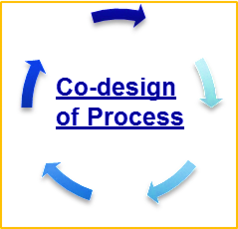
Hospital Handovers with Co-Design & Implementation of
Processes with Patients, Family Caregivers and
Community Providers
Primary & Specialty Care
Home (Patient & Family Caregivers)
Hospitals
Home Health Care
Skilled Nursing Care Centers
Assessment of Needs
Plan post-acute FU Plans
Handover
Communications
Teaching & Learning

Slide 29
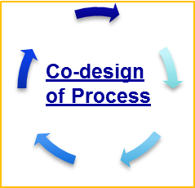
Skilled Nursing Facility Handovers with Co-Design & Implementation of Processes with Patients, Family
Caregivers and Community Providers
Assessment of Needs
Plan post-acute FU Plans
Handover
Communications
Teaching & Learning
Home (Patient & Family Caregivers)
Primary & Specialty Care
Home Health Care
Skilled Nursing Care Centers

Slide 30
Key Changes to Achieve an Ideal Transition from Hospital (or SNF) to Home
Perform an Enhanced Assessment of Post-Hospital Needs
Provide Effective Teaching and Facilitate Learning
  Ensure Post-Hospital Care Follow-Up
  Provide Real-Time Handover Communications

Slide 31
Key Changes to Achieve an Ideal Transition from Hospital (or SNF) to Home
“How can we gain a deeper understanding of the comprehensive post-discharge needs of the patient through an ongoing dialogue with the patient, family caregivers and community providers?”
“How can we gain a deeper understanding of patient and family caregiver understanding and comprehension of the clinical condition and self-care needs after discharge?”
“How can we develop a post-acute care plan based on the assessed needs and capabilities of the patient and family caregivers?”
“How can we effectively communicate post-acute care plans to patients and community-based providers of care?

Slide 32
High-Risk Patients | Moderate-Risk Patients | Low-Risk Patients
Patient has been admitted two or more times in the past year Patient or family caregiver is unable to Teach Back, or the patient or family caregiver has a low degree of confidence to carry out self-care at home | Patient has been admitted once in the past year Patient or family caregiver is able to Teach Back most of discharge information and has a moderate degree of confidence to carry out self-care at home | Patient has had no other hospital admissions in the past year Patient or family caregiver has a high degree of confidence and able Teach Back how to carry out self-care at home

Slide 33
High-Risk Patients | Moderate-Risk Patients | Low-Risk Patients
Prior to discharge: Schedule a face-to-face follow-up visit within 48 hours of discharge. Care teams should assess whether an office visit or home health care is the best option for the patient. If a home health care visit is scheduled in the first 48 hours, an office visit must also be scheduled within 5 days. Initiate intensive care management programs as indicated (if not provided in primary care or in outpatient specialty clinics (e.g. heart failure clinics) Provide 24/7 phone number for advise about questions and concerns. Initiate a referral to social services and community resources as needed | Prior to discharge: Schedule a follow-up phone call within 48 hours of discharge and schedule a physician office visit within 5 to 7 days. Initiate home health care or transitional care services (eg. CTI) as needed. Provide 24/7 phone number for advise about questions and concerns. Initiate a referral to social services and community resources as needed. | Prior to discharge: Schedule a follow-up phone call within 48 hours of discharge and schedule a physician office visit as ordered by the attending physician. Provide 24/7 phone number for advise about questions and concerns. Initiate a referral to social services and community resources as needed.

Slide 34
Reception into Skilled Nursing Facilities with Co-Design & Implementation of Processes with Patients, Family
Caregivers and Hospitals
Review Plan (Ready & Capable to Care for Resident ?)
Reconcile Treatment Plan & Proactive Planning
Plan for Timely Consultation when Status Changes
Home (Patient & Family Caregivers)
Hospitals
Skilled Nursing Care Centers

Slide 35
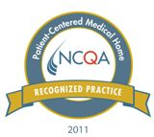

Reception into Primary & Specialty Care with Co-Design & Implementation of Processes with Patients, Family Caregivers,
Hospitals and Community Providers
Hospitals
Primary & Specialty Care
Home (Patient & Family Caregivers)
Home Health Care
Skilled Nursing Care Centers
Timely Access
Review Plan & Visit Prep
Assess, Plan & Self-Management Support
Coordinate Care

Slide 36
Reception into Home Health Care with Co-Design &
Implementation of Processes with Patients, Family Caregivers, Hospitals and Community Providers
Assess, Plan & Self-Management Support
Review Home Care Plan
Coordinate Care
Hospitals
Home (Patient & Family Caregivers)
Home Health Care
Primary & Specialty Care
Skilled Nursing Care Centers

Slide 37
Improving Transitions and Reducing Avoidable Rehospitalizations
Will
RESULTS
New
possibilities
Build
confidence
Ideas
Sequencing and tempo
Execution
Notes:
Hospitals are increasingly launching into new improvement projects with goals to improve outcomes, efficiency, quality, costs, and safety. Organizations devote time, resources, and human capital to increase the safety and efficiency of patient care. However, according to a recent study by Aiken and colleagues, up to 70 percent of all change fails. [Aiken C, Keller S, Rennie M. The Performance Culture Imperative. McKinsey & Co.] Why does this happen when well-intentioned people set out to improve what they do? It is largely because many institutions have expertise in the important clinical elements that need improving, but lack skills in the operational processes that act as the engine needed to drive improvement. For a portfolio of improvement projects to truly achieve success at the system level, a proficient operational skill set is required.
The Goal
To help organizations operationalize improvement across their systems, the Institute for Healthcare Improvement (IHI) is offering its latest Expedition titled, Successful Execution: Securing the Link from Aims to Results. This five-part, web-based program will help you to achieve breakthrough levels of performance by demonstrating how to implement a framework of execution rooted in the elements of Will, Ideas, and Execution, an IHI model for improvement.
This framework involves:
Setting appropriate goals
Developing a portfolio of projects
Deploying resources appropriately
Establishing an oversight and learning system to increase the likelihood of producing intended results from improvement initiatives
Expert faculty will explain all the components of the framework using real-world examples. They will then work with participants on how to apply the framework to take their organization’s improvement efforts to the next level — a level where change is identified, and spread and sustainability are designed into the system to create a cycle of continuous learning.
Objectives
At the conclusion of this Expedition, participants will be able to:
Set a breakthrough aim for their organization
Design a portfolio of projects with appropriate staffing and resources
Formulate a plan to build or ensure improvement capability
Convene a cross-functional team for an oversight meeting
Execute a plan that can be applied over time, in other years, with other departments or programs in the organization

Slide 38
Aim Statement #1
Shady Oaks Hospital will improve transitions home for all heart failure patients as measured by a reduction in unplanned 30-day all-cause readmission rates for heart failure patients (decreasing the rate from 25% to 15% or less in 18 months).
Strategy: Consider adding APN(s) or case manager(s) to implement and/or oversee the initial implementation of the recommended changes for patients with HF and coordinate HF care with clinicians and staff community care settings.

Slide 39
Aim Statement #2
Sunny Skies Hospital will improve transitions home for all patients with heart failure, AMI or pneumonia as measured by a reduction in unplanned 30-day all-cause readmission rates for these 3 populations in the next 18 months.
Strategy: Select one medical unit (with a high rate of readmissions) to implement the recommended changes for all patients; and simultaneously develop the infrastructure and supports necessary for the scale-up and spread of the successful changes to all medical units.

Slide 40
Aim Statement #3
Bubbling Brook Hospital will improve transitions home for all patients as measured by a decrease in the 30-day all-cause hospital readmission rate from 12% to 8% percent or less within 24 months. We will start our improvement work with patients on 4W and 5S. We will expect to see a decrease in the readmission rates for patients discharged from those units of at least 10% within 12 months.
Strategy: Implement the recommended changes for all patients on 4W and 5S; and simultaneously develop the infrastructure and supports necessary for the scale-up and spread of the successful changes hospital-wide.

Slide 41
Front-line Improvement Team:
Testing Changes and Designing Reliable Processes
Start by focusing on one of the key changes
Identify the opportunities/failures/successes in the current processes and select a process to work on
Conduct iterative PDSA cycles (tests of change)
Specify the who, what, when, where and how for the process (standard work)
Understand common failures to redesign the process to eliminate those failures
Use process measures to assess your progress over time (aim is to achieve > 90% reliability)
Implement and spread successful changes

Slide 42
Testing and Implementing Changes
changes that result in improvement
Act
Plan
Cycle 8
Study
Do
data for learning
Cycle 7
Cycle 6
Cycle 5
Cycle 4
Cycle 3
Cycle 2
hunches, theories & ideas
Cycle 1

Slide 43

Notes:
Initial focus of work should be on “getting the process right” with a known connection to an outcome
Taking a set of processes to a agreed upon level of reliability within a specified timeline
Teams will use reliability design principles in improvement work not just hard work and vigilance
Teams will develop good designs by using rapid cycle small tests of change

Slide 44
Improving Transitions and Reducing Avoidable Rehospitalizations
Will
RESULTS
New
possibilities
Build
confidence
Ideas
Sequencing and tempo
Execution
Notes:
Hospitals are increasingly launching into new improvement projects with goals to improve outcomes, efficiency, quality, costs, and safety. Organizations devote time, resources, and human capital to increase the safety and efficiency of patient care. However, according to a recent study by Aiken and colleagues, up to 70 percent of all change fails. [Aiken C, Keller S, Rennie M. The Performance Culture Imperative. McKinsey & Co.] Why does this happen when well-intentioned people set out to improve what they do? It is largely because many institutions have expertise in the important clinical elements that need improving, but lack skills in the operational processes that act as the engine needed to drive improvement. For a portfolio of improvement projects to truly achieve success at the system level, a proficient operational skill set is required.
The Goal
To help organizations operationalize improvement across their systems, the Institute for Healthcare Improvement (IHI) is offering its latest Expedition titled, Successful Execution: Securing the Link from Aims to Results. This five-part, web-based program will help you to achieve breakthrough levels of performance by demonstrating how to implement a framework of execution rooted in the elements of Will, Ideas, and Execution, an IHI model for improvement.
This framework involves:
Setting appropriate goals
Developing a portfolio of projects
Deploying resources appropriately
Establishing an oversight and learning system to increase the likelihood of producing intended results from improvement initiatives
Expert faculty will explain all the components of the framework using real-world examples. They will then work with participants on how to apply the framework to take their organization’s improvement efforts to the next level — a level where change is identified, and spread and sustainability are designed into the system to create a cycle of continuous learning.
Objectives
At the conclusion of this Expedition, participants will be able to:
Set a breakthrough aim for their organization
Design a portfolio of projects with appropriate staffing and resources
Formulate a plan to build or ensure improvement capability
Convene a cross-functional team for an oversight meeting
Execute a plan that can be applied over time, in other years, with other departments or programs in the organization

Slide 45
It Takes a Village…
It takes a village to raise a child.
- African proverb
It takes a village to improve the quality of the patients’ experience during transitions from hospital to home or other care settings and to reduce avoidable rehospitalizations.
- STAAR proverb

