Slide 1

Transitional Care Nursing
Jason Marchi, RN, BSN
Carolyn Fenn, MS, LSW
April 23, 2012
Maristhill Nursing & Rehabilitation Center

Slide 2
Role of Transitional Care Nurse
Liaison between referring hospitals
Interdisciplinary Coordinator
Case manager and patient/family advocate
Patient/family educator
Quality improvement initiator
Contact for community clinicians

Slide 3
Coordinating with Hospitals
Careful review of discharge summaries prior to patient arrival
Follow up with hospital staff for questions/concerns
Frank discussion of hospital clinicians’ concerns or “gut feeling” about a given patient’s needs
Communication is key to effective “warm hand-off”

Slide 4
Coordinating with Community Clinicians
Involvement of home services prior to discharge
Collaboration with PCP’s for ease of transition and facilitation of new needs
Continued communication with home services
Follow up within one week with patient/family for needs assessment

Slide 5
Managing Recidivism
Implementation of Interact QI tool
Weekly group meetings with Administrator, DON, and allied disciplines for needs assessment, case studies, and “lessons learned”
Communication with covering physicians as to Maristhill’s treatment capabilities
Discussions with patients and families about the principles and benefits of advanced directives

Slide 6
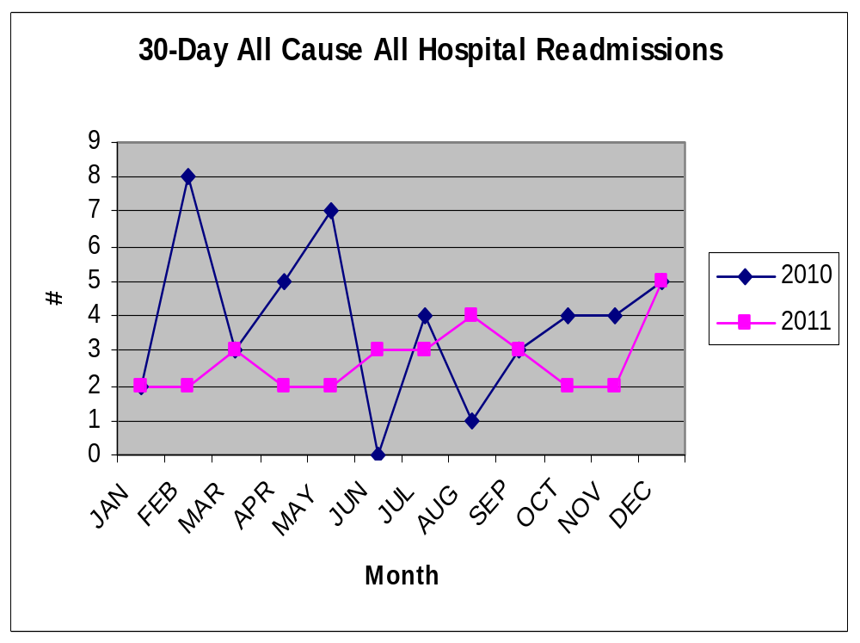

Slide 7
BASELINE READMISSION RATE (2010) = 25%
Developed and implemented tracking system
PHASE II READMISSION RATE (2011) = 19%
Education, introductory phases of INTERACT tools
Beginning implementation of in-depth QA
Hired Care Transitions Nurse, August, 2011
PHASE III GOAL READMISSION RATE (2012) = 10%
Reduce readmissions of long-term residents by 50%
Increase use of palliative care/pastoral staff
Implement formal protocol for clinical education/advance care planning for all patients

Slide 8
Surprises & opportunities
Importance of “person-to-person” contact
Patient/family lack of knowledge about their medical condition, prognosis
Variability in recidivism rates among hospitals
Staff “culture change” around treating in place: the role of confidence, skills, empowerment in successful outcomes

