Slide 1

Reliable Implementation and
Scale-up of Changes
Gail Nielsen, BSHCA, FAHRA, RTR
Pat Rutherford, MS, RN
April 23, 2012
These presenters have nothing to disclose.

Slide 2

Session Objectives
Participants will be able to:
Describe strategies for designing and implementing reliable processes to achieve desired outcomes
Discuss strategies for developing the infrastructure and plan for sustaining improvements and spreading successful changes

Slide 3
Execution of Strategic
Quality Improvement Initiatives
1. Setting Priorities and Breakthrough Performance Goals
2. Developing a Portfolio of Projects to Support the Goals
3. Deploying Resources to the Projects That Are Appropriate for the Aim
4. Establishing an Oversight and Learning System to Increase the Chance of Producing the Desired Change
Nolan TW. Execution of Strategic Improvement Initiatives to Produce System-Level Results. IHI Innovation Series white paper. Cambridge, MA: Institute for Healthcare Improvement; 2007.

Slide 4
Aim Statement #1
Shady Oaks Hospital will improve transitions home for all heart failure patients as measured by a reduction in unplanned 30-day all-cause readmission rates for heart failure patients (decreasing the rate from 25% to 15% or less in 18 months).
Strategy: Consider adding APN(s) or case manager(s) to implement and/or oversee the initial implementation of the recommended changes for patients with HF and coordinate HF care with clinicians and staff community care settings.

Slide 5
Aim Statement #2
Sunny Skies Hospital will improve transitions home for all patients with heart failure, AMI or pneumonia as measured by a reduction in unplanned 30-day all-cause readmission rates for these 3 populations in the next 18 months.
Strategy: Select one medical unit (with a high rate of readmissions) to implement the recommended changes for all patients; and simultaneously develop the infrastructure and supports necessary for the scale-up and spread of the successful changes to all medical units.

Slide 6
Aim Statement #3
Bubbling Brook Hospital will improve transitions home for all patients as measured by a decrease in the 30-day all-cause hospital readmission rate from 12% to 8% percent or less within 24 months. We will start our improvement work with patients on 4W and 5S. We will expect to see a decrease in the readmission rates for patients discharged from those units of at least 10% within 12 months.
Strategy: Implement the recommended changes for all patients on 4W and 5S; and simultaneously develop the infrastructure and supports necessary for the scale-up and spread of the successful changes hospital-wide.

Slide 7
What is the will and level of ambition at your organization or clinical setting?
Considering all of your organization’s strategic priorities, what is your aim for reducing readmissions?

Slide 8
Achieving Desired Results in the MA STAAR Collaborative
Will
RESULTS
New
possibilities
Build
confidence
Ideas
Sequencing and tempo
Execution
Notes:
Hospitals are increasingly launching into new improvement projects with goals to improve outcomes, efficiency, quality, costs, and safety. Organizations devote time, resources, and human capital to increase the safety and efficiency of patient care. However, according to a recent study by Aiken and colleagues, up to 70 percent of all change fails. [Aiken C, Keller S, Rennie M. The Performance Culture Imperative. McKinsey & Co.] Why does this happen when well-intentioned people set out to improve what they do? It is largely because many institutions have expertise in the important clinical elements that need improving, but lack skills in the operational processes that act as the engine needed to drive improvement. For a portfolio of improvement projects to truly achieve success at the system level, a proficient operational skill set is required.
The Goal
To help organizations operationalize improvement across their systems, the Institute for Healthcare Improvement (IHI) is offering its latest Expedition titled, Successful Execution: Securing the Link from Aims to Results. This five-part, web-based program will help you to achieve breakthrough levels of performance by demonstrating how to implement a framework of execution rooted in the elements of Will, Ideas, and Execution, an IHI model for improvement.
This framework involves:
Setting appropriate goals
Developing a portfolio of projects
Deploying resources appropriately
Establishing an oversight and learning system to increase the likelihood of producing intended results from improvement initiatives
Expert faculty will explain all the components of the framework using real-world examples. They will then work with participants on how to apply the framework to take their organization’s improvement efforts to the next level — a level where change is identified, and spread and sustainability are designed into the system to create a cycle of continuous learning.
Objectives
At the conclusion of this Expedition, participants will be able to:
Set a breakthrough aim for their organization
Design a portfolio of projects with appropriate staffing and resources
Formulate a plan to build or ensure improvement capability
Convene a cross-functional team for an oversight meeting
Execute a plan that can be applied over time, in other years, with other departments or programs in the organization

Slide 9

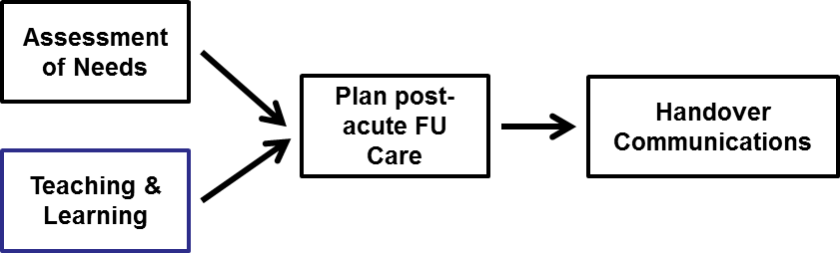
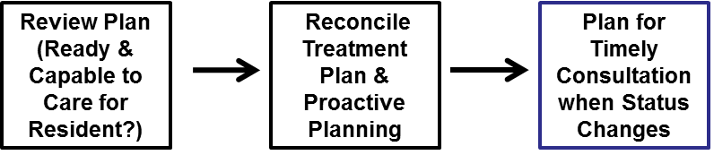

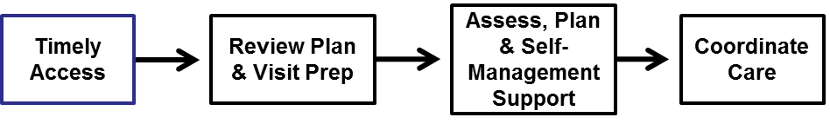

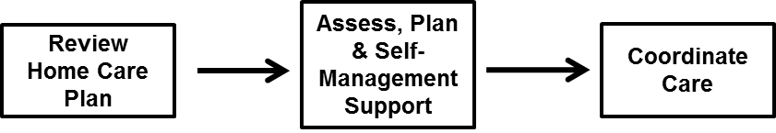
Process Changes to Achieve an Ideal Transition from Hospital (or SNF) to Home
Skilled Nursing Care Centers
Hospital
Primary & Specialty Care
Home (Patient & Family Caregivers)
Home Health Care

Slide 10
Front-line Improvement Team:
Testing Changes and Designing Reliable Processes
Start by focusing on one of the key changes
Identify the opportunities/failures/successes in the current processes and select a process to work on
Conduct iterative PDSA cycles (tests of change)
Specify the who, what, when, where and how for the process (standard work)
Understand common failures to redesign the process to eliminate those failures
Use process measures to assess your progress over time (aim is to achieve > 90% reliability)
Implement and spread successful changes

Slide 11
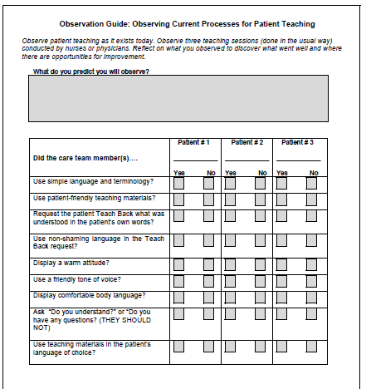

Slide 12
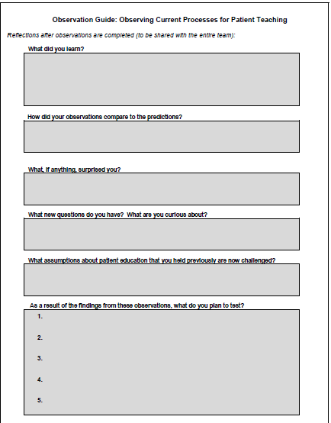

Slide 13
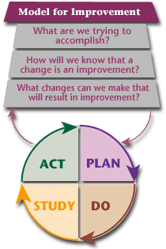


Slide 14
Suggestions for Conducting
PDSA Cycles
Remember that one test of change informs the next.
Keep tests small; be specific.
Refine the next test based on learning from the previous one.
Expand test conditions to determine whether a change will work at different times of day (e.g., day and night shifts, weekends, holidays, when the unit is adequately staffed, in times of staffing challenges).
Continue the cycle of learning and testing to improve process reliability.
Collect sufficient data to evaluate whether a test has promise, was successful, or needs adjustment.
For more information on the Model for Improvement and on selecting and testing changes, explore this link
  http://www.ihi.org/IHI/Topics/Improvement/ImprovementMethods/HowToImprove/.

Slide 15
Testing and Implementing Changes
changes that result in improvement
Act
Plan
Cycle 8
Study
Do
data for learning
Cycle 7
Cycle 6
Cycle 5
Cycle 4
Cycle 3
Cycle 2
hunches, theories & ideas
Cycle 1

Slide 16
Example of Iterative PDSA Cycles to Improve Patient Understanding using Teach Back
Cycle 1: One nurse, on one day, tests whether using Teach Back with one patient who has heart failure (HF) helps the patient learn the reasons to call the physician for help after discharge. The nurse learned that materials were confusing to the patient.
Cycle 2: Nurse revises the teaching materials to identify key points by circling them. The nurse runs a second PDSA cycle with the same patient the next day and the patient can Teach Back the signs and symptoms, when and how to call his doctor.
Cycle 3: The nurse expands Teach Back to two patients, one has a designated learner, his daughter.
Cycle 4: The nurse tries a cycle of setting a learning appointment with a designated learner. This cycle is later abandoned due to complexity

Slide 17
Example of Iterative PDSA Cycles to Improve Patient Understanding using Teach Back (2)
Cycle 5: Nurse expands Teach Back to all patients with heart failure and spreads out the Teach Back sessions over several days during the stay.
Cycle 6: Nurse expands Teach Back to all her patients and designated learners
Cycle 7: The manager trains two nurses on each shift to begin using Teach Back and works on an educational module and competency assessment
Cycle 8: Teach Back is introduced to the weekend staff and two nurses from each shift are trained. Nurses begin sharing results of learning in shift report to coordinate who teaches what.
….additional cycles of testing until intent has been achieved

Slide 18

Notes:
Initial focus of work should be on “getting the process right” with a known connection to an outcome
Taking a set of processes to a agreed upon level of reliability within a specified timeline
Teams will use reliability design principles in improvement work not just hard work and vigilance
Teams will develop good designs by using rapid cycle small tests of change

Slide 19
Use of Human Factors and
Reliability Science
  Standardize work processes
  Build job aides and reminders
  Take advantage of pre-existing work and habits
  Make the desired the default rather than the exception
  Create redundancy
  Bundle related tasks

Slide 20
Specify the Standard Work
Ask yourself, “What would I see if I could observe
this being done?”
Select a process and precisely describe the standard work,
including information regarding:
  Who does it;
  What do they do;
  When do they do it (and for which patients);
  Where do they do it;
  How do they do it (include tools that are used);
  How often do they do it; and
  Why do they do it.
Notes:
Ask, “What would I see if I could observe this being done?” Design the work to be flawless, each and every time, regardless of who does it. Use aids and reminders. Design these tools into the system. Use information technology to assist design.

Slide 21
Example of Work Specification
Who will do it -- be specific; include the name of the nurse assigned to the patient
What will they do -- use Ask Me 3 framework to organize teaching for all patients and each patient is asked in a non-shaming way to describe in their own words what was learned; patient’s understanding is documented in the patient’s record so that at discharge, details on the patient’s ability to Teach Back the key points about self-care can be transferred to the next site of care.

Slide 22
Example of Work Specification (2)
When will they do it -- during second hourly rounding of shift
Where will they do it -- in the patient’s room
How do they do it -- use the Teach Back documentation tool in patient’s chart
How often will they do it -- once each shift
Why should they do it -- to enhance learning and identify patients who are at risk for problems while caring for themselves post-discharge

Slide 23
Specification of Work
Allows less than perfect design in the initial specifications (we do not have to plan for every possible contingency)
No need to spend months coming up with the perfect design
Assumes that the observation of failures in the process will lead to further redesign of the process
Build knowledge of how to design the process over time

Slide 24
Signaling Failures
For each testing cycle, study the results and learn about failures
  Was the test successful? Yes or No
  If it failed, how do staff report the failure
Examples: failure to make the follow-up MD visit appointment before patients are discharged
  Clerical staff tell the unit manager whenever they could not make an appointment and describe why they weren’t successful
  Notations on the unit manager’s office door

Slide 25
Learning from a Failed Test
The nurses were using the Ask Me 3 framework with all patients. A nurse caring for a patient with chronic depression found that the Ask Me 3 questions were not relevant in assisting her with patient education.
The nurses, physicians, and social workers met to delineate the relevant Ask Me 3 questions for patients with mental health conditions and redesigned tools and guidelines for patient education.

Slide 26
Using Process Measures to Evaluate the
Reliable Implementation of Changes
Process Measures tell us whether the specific changes we are making are working as planned. When displayed in annotated run charts, they give us feedback on the relationship between our theory (e.g. better patient understanding of self-care at home using Teach Back). and the outcomes for our patients.
The following slide is an example of an annotated run chart for the process measure for assessing the outcomes when using Teach Back.
Notes:
By shorter cycle feedback I mean shorter than our outcome measures…

Slide 27
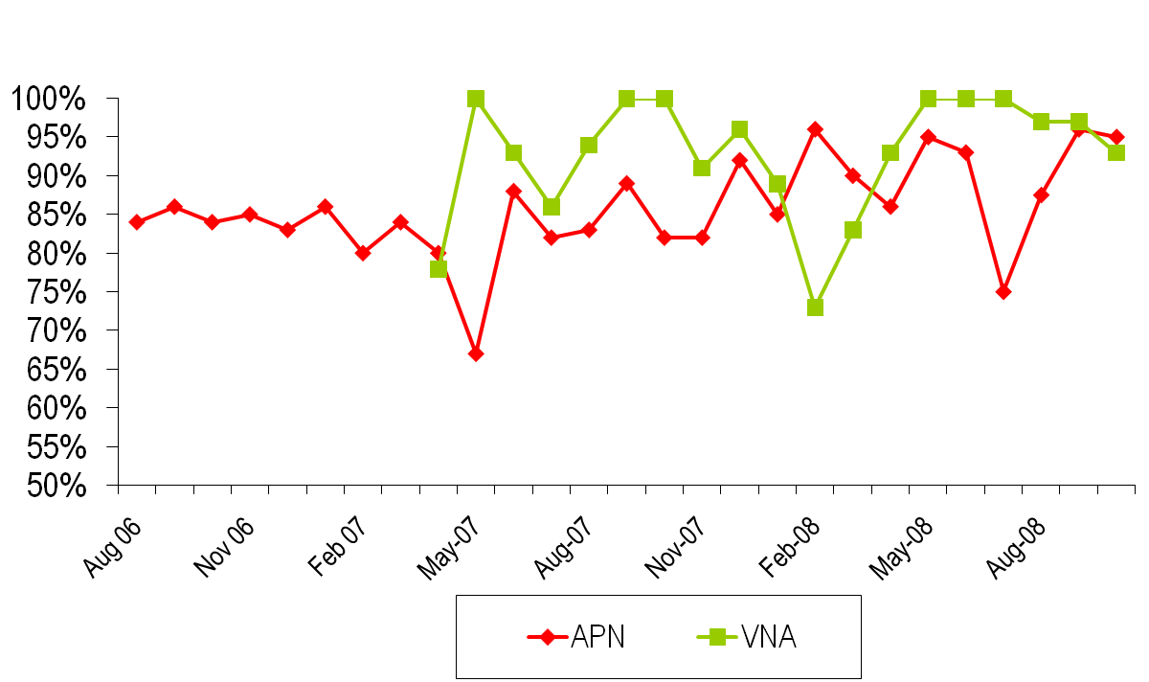

Process Measure:
Patient Responses Using Teach Back*
Follow-up phone calls initiated
Nurse competencies evaluations in health literacy started
VNA teach back initiated
*Percent of complete patient responses in Teach Back conducted by VNA
at 24 to 48 hours post-discharge home visit and the follow-up phone call
by hospital-based APN 7 days after discharge

Slide 28
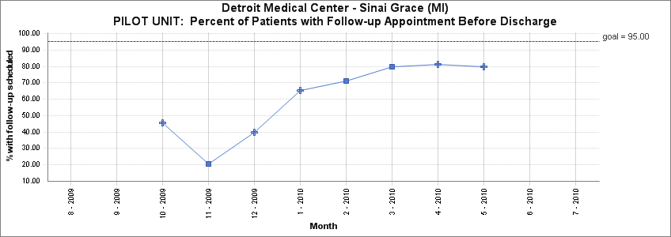

Slide 29
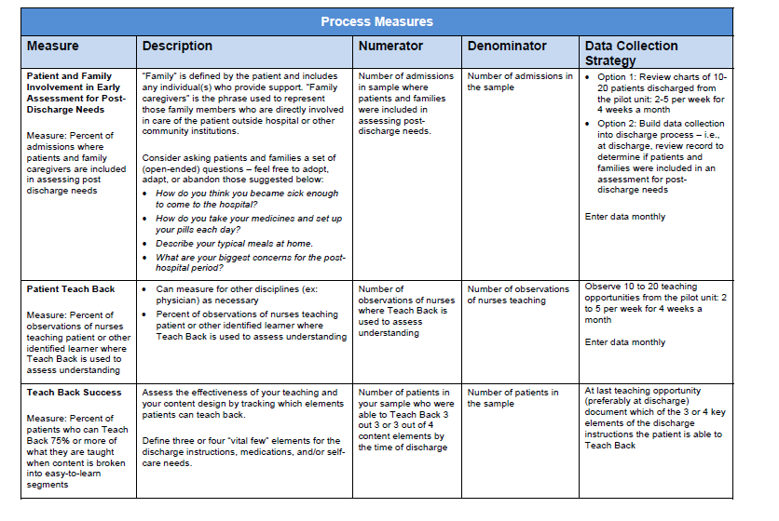

Slide 30
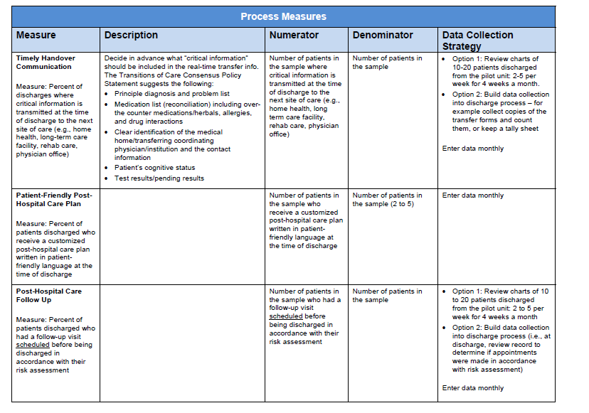

Slide 31
Example of Implementation
During the testing process, a few nurses learned Teach Back. Once the processes and support materials have been adapted so that these nurses teach the identified learners effectively over 90 percent of the time, those processes should be implemented across the unit. Making these processes the default system (i.e., the way the work is done rather than the way a few nurses do the work from time to time) requires a training system for all nurses currently on the unit, and changes to orientation programs for new nurses.

Slide 32
Sustaining Improvements
Communicate aims and successful changes that achieved the desired results (e.g. newsletters, storyboards, patient stories, etc.)
Improvements must be “hard-wired” so that the new processes are difficult to reverse (e.g. IT templates, yearly competencies, role descriptions, policies and procedures)
  Assign ownership for oversight and ongoing quality control to “hold the gains”
Embedding ongoing measurement of processes and outcomes will aid in sustaining the gains

Slide 33
Evaluating Results and Spreading Successes
Change 1
Change 2
Change 1
Change 2
Observed
Data
Change 2
Change 1
Design Target
Time Order (Monthly Data)
Pilot Unit #1
Pilot Unit #2
All Med/Surg Units

Slide 34
Scale-up of Hospital-based Process Improvement Changes in STAAR
Many sites with pilot population results have added staffing resources
  Not a scalable, sustainable solution
  Need to remove waste and inefficiencies from front-line clinicians’ daily work and reliably embed new competencies and best practices into routine care processes and infrastructure
Full-scale implementation of successful changes (embedding high leverage changes as standard practices in front-line work processes)
  No successes to date nationwide; no incentives for full-scale implementation (and in some cases may result in revenue losses for hospitals);
  Initial focus on condition-specific interventions (mostly HF patients) >> sequential spread to patients with high-risk clinical conditions is not practical; focus on improving care transitions for all patients is the “right thing to do”; visionary leadership is a pre-requisite for engaging in this work
  Will require executive leadership, a robust improvement infrastructure, structural changes and a oversight and learning system to achieve full-scale implementation of successful changes
Notes:
Start Pat/Saranya

Slide 35
Planning for Scale-up & Spread
To scale up the change across the hospital might require changes to an IT documentation system. Communication to all staff about new expectations for teaching and learning might be developed to generate interest in implementing the redesigned process in other parts of the hospital (e.g., in other units or service lines) or with other disciplines (like physicians, or pharmacists) in preparation for spread.

Slide 36
Scale-up Planning at SG
Define targeted scale at project setup = all hospitalized patients at SG
Being aware of need for systemic changes at each level of scale-up as you expand
Collaborations with the executive team at SG. What structures need to change to accommodate scale-up?
  Administration structures (integrated in ACO demo)
  Contracted services (ex. Loop Back Communications)
  Responsibility, accountability and oversight structures
  Physical structures
  Human resource requirements
  Capability building (ex. new competencies for health care professionals such as health literacy, Teach Back and Ask Me 3)
  EHR/HIT programming

Slide 37
Initial Scale-up Work at SG
  Implement changes to reduce waste and inefficiencies to allow nurses to spend more time with patients doing assessments of post-discharge needs and patient teaching; embed recommend changes #1 and #2 into daily nursing routines
  Use daily Multidisciplinary Care Rounds as a forum to assess comprehensive needs of patients and to establish a post-acute care plan (change #3)to meet those needs, keeping track of what services couldn’t be provided
  Develop standardized processes and formats to communicate post-discharge plans to patients and all community-based providers (change #4)

Slide 38
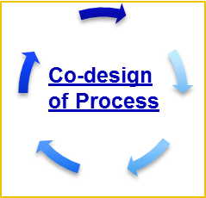
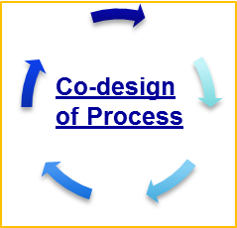
Hospital Handovers with Co-Design & Implementation of
Processes with Patients, Family Caregivers and
Community Providers
Primary & Specialty Care
Home (Patient & Family Caregivers)
Hospitals
Home Health Care
Skilled Nursing Care Centers
Assessment of Needs
Plan post-acute FU Plans
Handover
Communications
Teaching & Learning

Slide 39
Spread from Pilot Units to Clinical Departments to Entire Hospital
….redesigning care processes to improve transitions for all patients
Entire Hospital
All Surgical Units
All Medical Units
Pilot Population or Unit(s)

Slide 40
Monitoring the Spread Plan
100%
6E
6N
7E
7N
7S
Health
Literacy
Daily Goals
Completeness
Enhanced
Assessment
Med Rec
Real-time
Handovers
Follow-up
Appts
100%
Coverage
Notes:
Preparing for Spread
Document results (data)
Build awareness of work & results
Sell benefits of the changes
Identify senior leader(s) responsible for spread
Use original team as technical advisors

